Slide 1
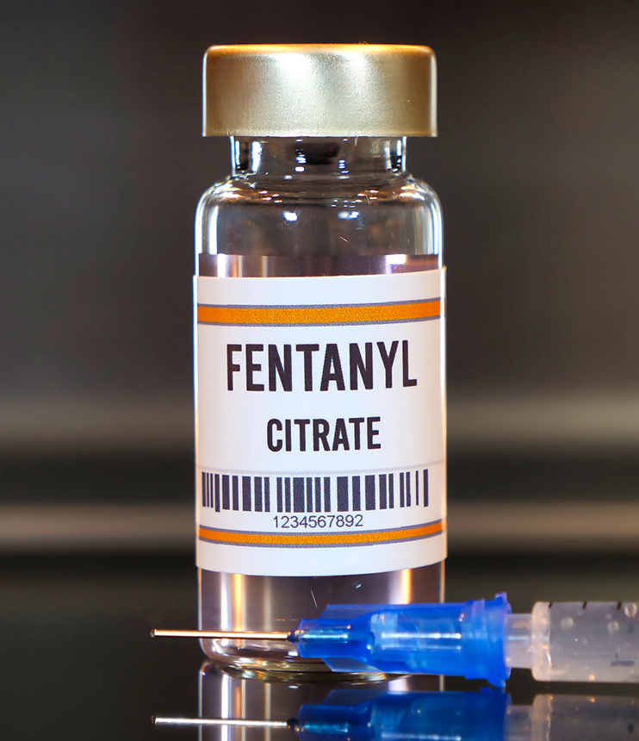
Opioid Epidemic
Presented by: Ilissa Garcia
Notes:
Line spacing + Page numbers

Slide 2

Overview
The fentanyl epidemic presents a public health crisis, with a significant increase in Opioid-related deaths in recent years. This project aims to address this urgent issue by analyzing data to understand the underlying factors contributing to these deaths. Understanding the causes and patterns of Opioid-related deaths is crucial for developing evidence-based interventions, informing policy decisions, and saving lives. My analysis seeks to provide valuable insights that can make a meaningful impact on public health efforts to combat the fentanyl epidemic.

Slide 3
"What are the key factors associated with Opioid-related deaths, and how can data guide public health interventions and policies?"

Slide 4
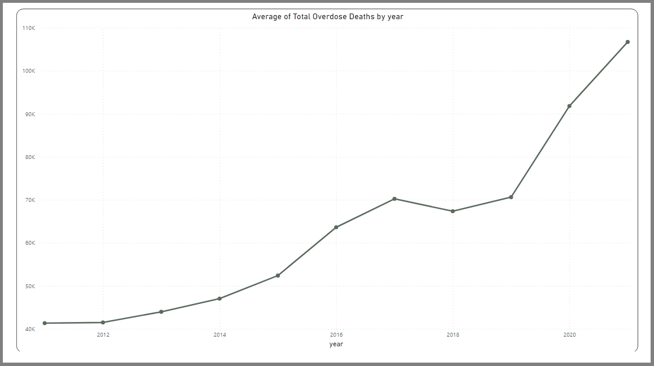

Slide 5
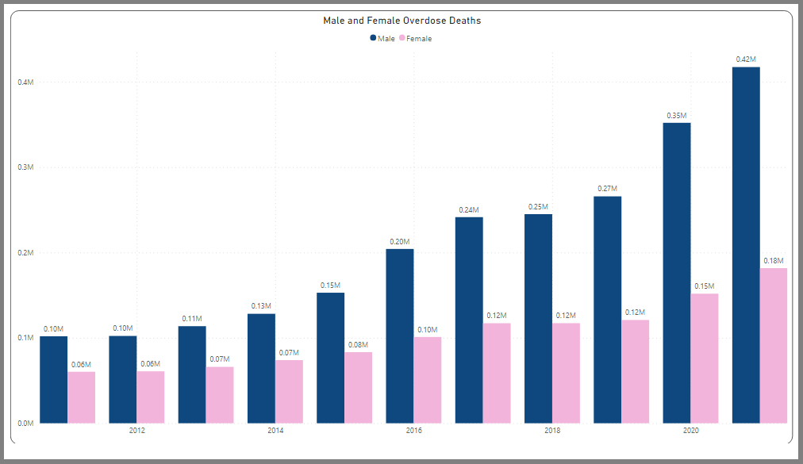

Slide 6
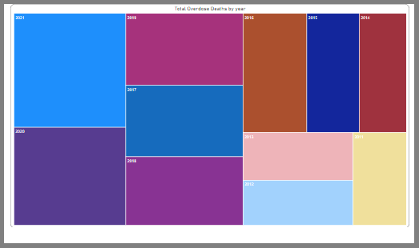
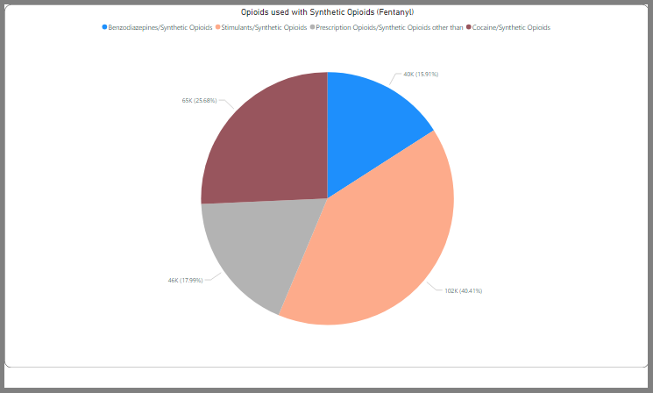
Notes:
Pie – 2011-2021

Slide 11

Drug Courts
About half of the 7 million people being supervised by the criminal justice system in some way (like being in prison or on probation) have a drug abuse or addiction problem. However, just punishing these individuals for their drug abuse isn't effective. It doesn't work well as a way to ensure public safety, especially when their crimes are directly linked to their drug use.
A comprehensive drug court system typically costs between $2,500-$4,000 annually for each offender, compared to $20,000-$50,000 per person per year to incarcerate a drug-using offender.
Increasing the number of drug courts is a crucial strategy in tackling the opioid overdose crisis. These specialized courts prioritize rehabilitation over punishment, directly addressing the underlying issue of addiction, which is often the root cause of drug-related offenses. Drug courts provide essential overdose prevention education and access to a range of support services, including addiction treatment, mental health counseling, and social services, all vital for overcoming opioid addiction. Furthermore, this approach is cost-effective compared to incarceration.It enhances community safety and health by reducing the burden on healthcare and law enforcement. With customized treatment plans, drug courts offer a more personalized and effective solution than traditional criminal justice proceedings. The regular monitoring and drug testing in these courts ensure accountability and provide a structured recovery environment, making drug courts a compassionate and effective approach to mitigate the opioid crisis.

Slide 12
Prescription drug monitoring programs (PDMPs)
Prescription Drug Monitoring Programs (PDMPs) are digital systems managed by state agencies. They keep track of how controlled substances, like certain prescription drugs, are prescribed and given out. PDMPs are used by doctors and pharmacists to see a patient's prescription history. Law enforcement can use them to spot illegal drug distribution or places that over-prescribe drugs. State medical boards also use PDMPs to watch for prescribers who might be giving out too many controlled substances. The drugs monitored and who can access the system, as well as how the system works, can differ from state to state.
There's some evidence showing that PDMPs can reduce both the amount and number of opioid prescriptions. They may also help decrease opioid overdose deaths. States with PDMPs often see less opioid misuse and fewer hospital admissions due to opioid-related issues compared to states without PDMPs. PDMPs can also reduce "doctor shopping," where patients visit multiple doctors to get the same drug. Experts suggest that PDMPs should be easy to use, accessible across states, open for all prescribers to register, include mandatory reporting from pharmacies, undergo regular evaluations, and be required in EDs.
Benefits
Reduced Overdose Deaths
Reduced Elicit Drug use

Slide 13
Conclusion
In conclusion, this capstone project has shed light on critical aspects of the fentanyl crisis. My analysis revealed trends, including the geographical hotspots of fentanyl-related incidents, demographic factors influencing vulnerability. These findings underscore the urgent need for comprehensive strategies and targeted interventions to combat this public health crisis effectively. To mitigate its devastating impact, policymakers, law enforcement agencies, healthcare providers, and community organizations should work collaboratively. While my study has provided valuable insights, it also highlights the complexity of the issue and the necessity for ongoing research and data-driven initiatives to inform evidence-based solutions. Addressing the fentanyl crisis demands a multi-faceted approach that combines data analysis, public awareness, and policy action to save lives and protect communities.

Slide 14
How has the prevalence of fentanyl-related overdose deaths evolved over time, and are there any significant trends or patterns?
What demographic factors, such as age, gender, and location, are associated with a higher risk of fentanyl overdose?
What are the primary sources and distribution channels of illicit fentanyl, and how have they changed over the years?
How do public perceptions and media coverage of the fentanyl epidemic affect policy decisions, public awareness, and the allocation of resources for prevention and treatment?
Are there geographic hotspots or clusters of fentanyl-related overdose deaths, and if so, what factors contribute to their concentration in those areas?

